Slide 1


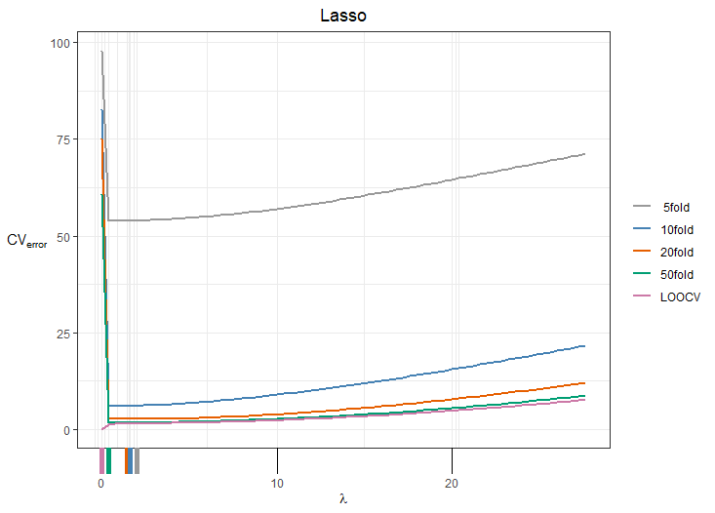
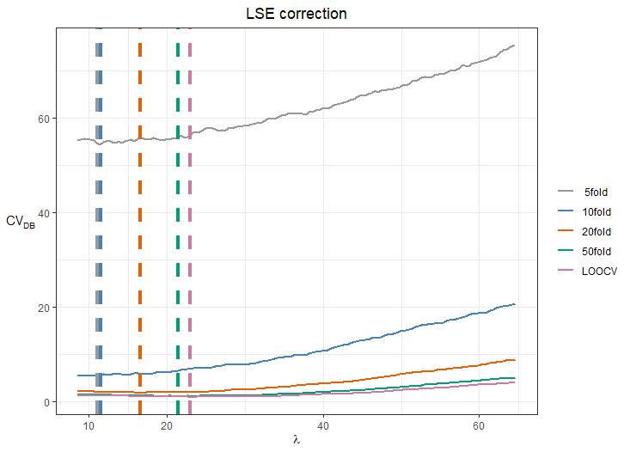
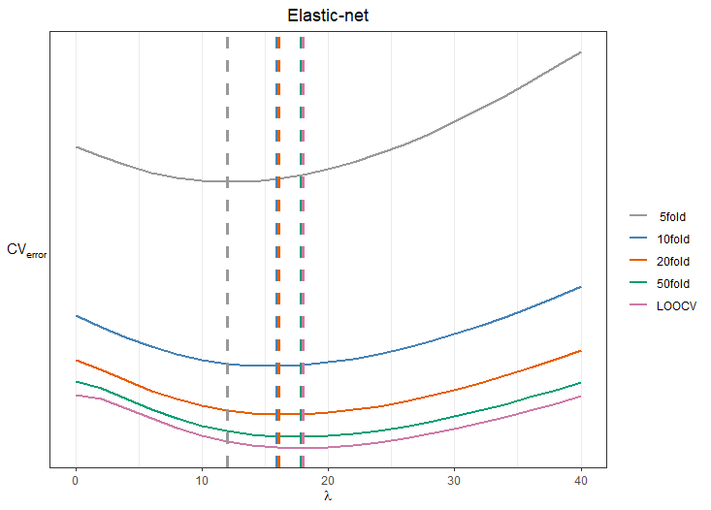
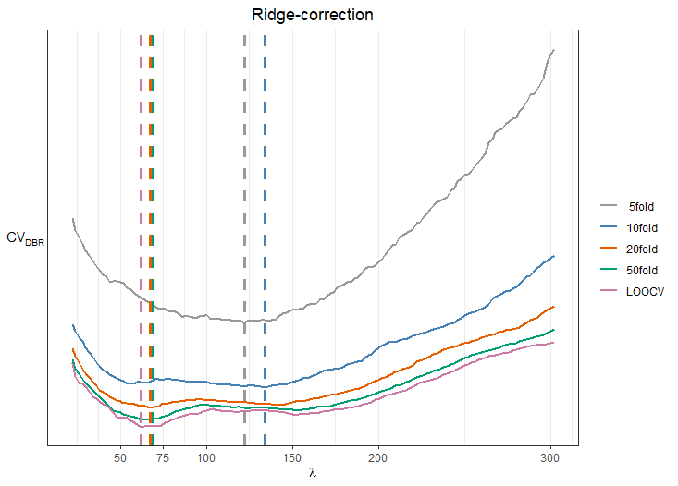
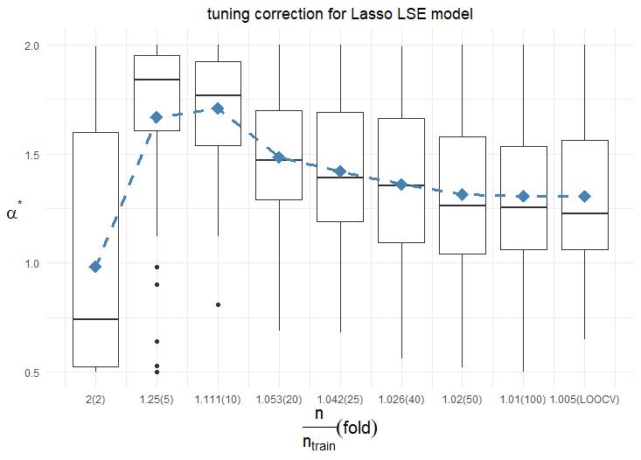
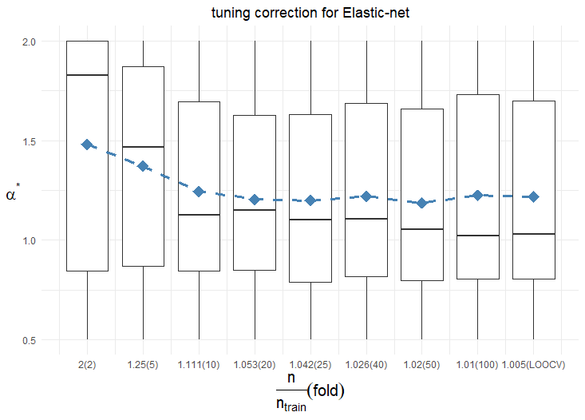
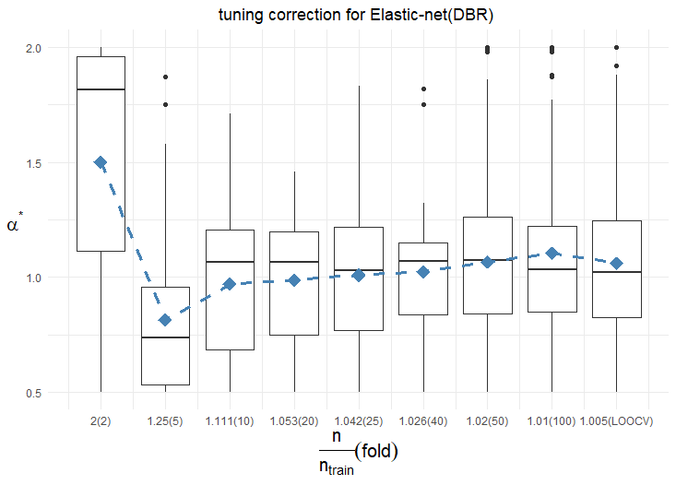
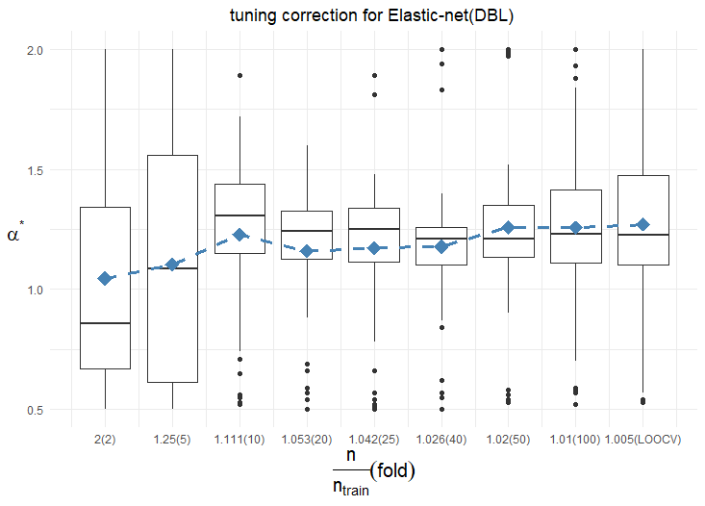
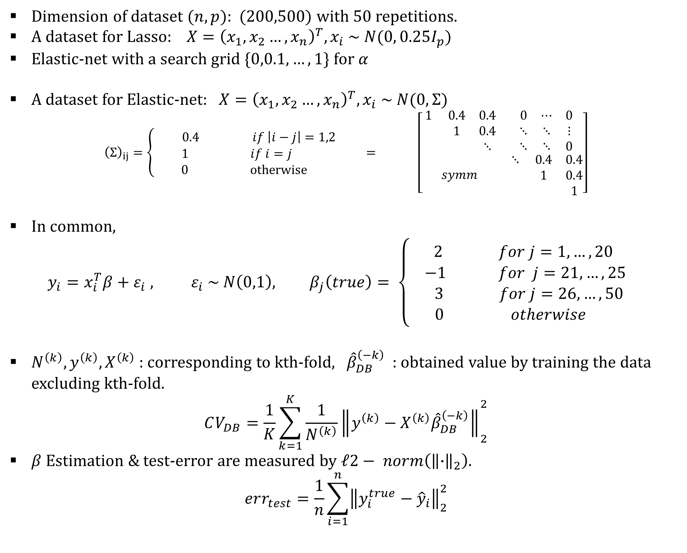
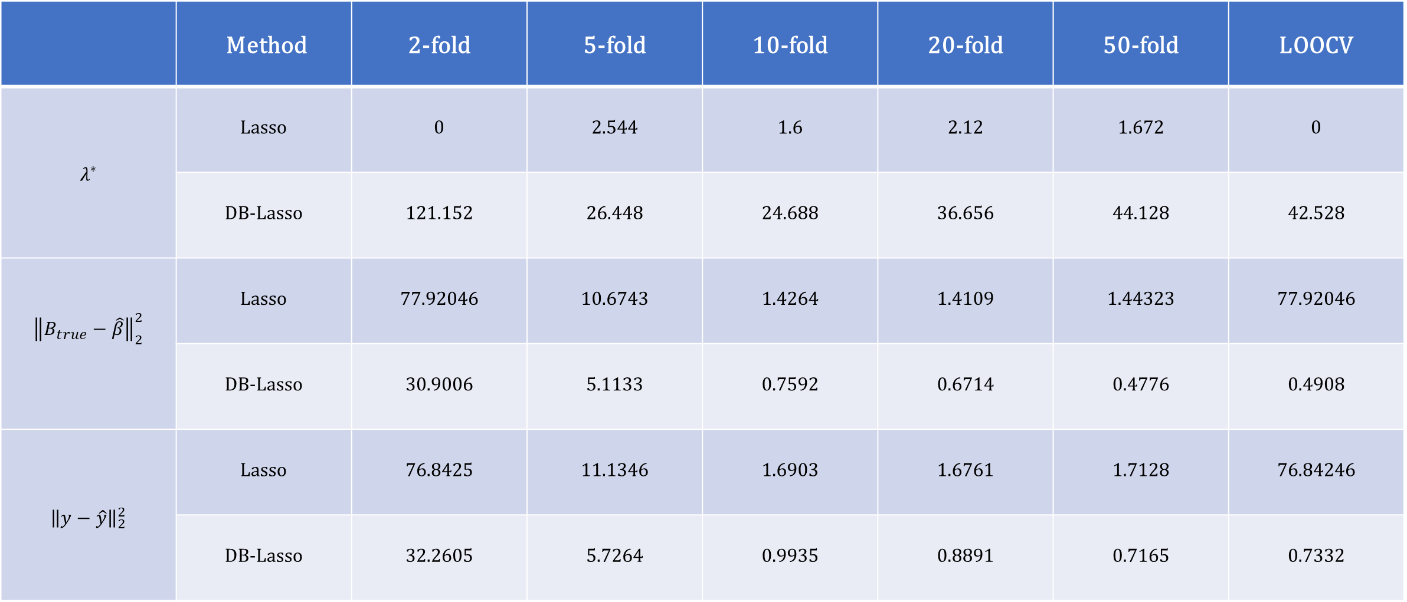
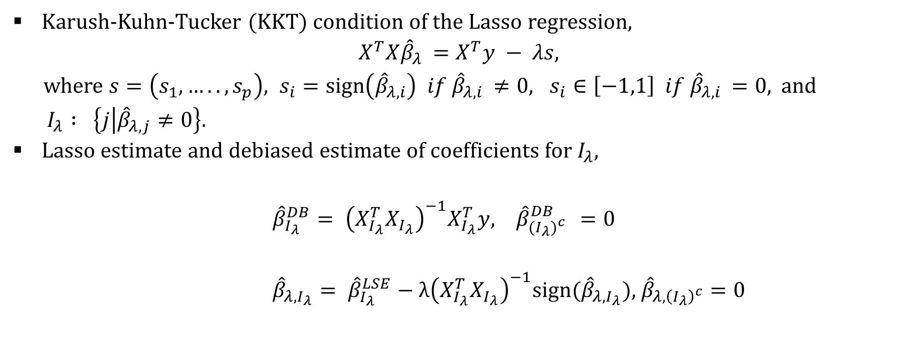

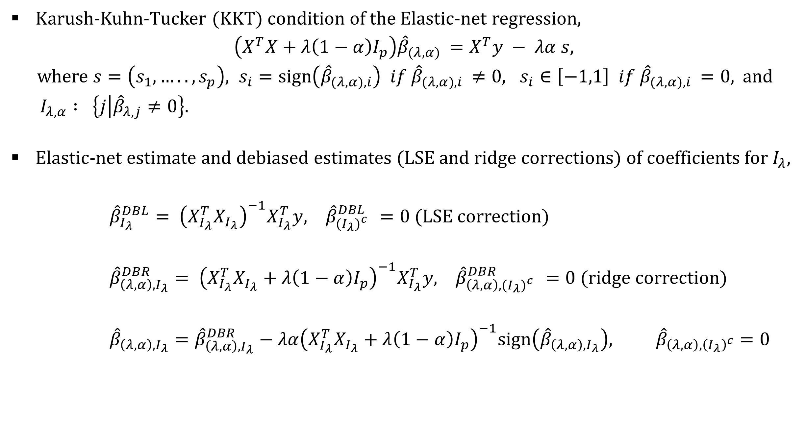
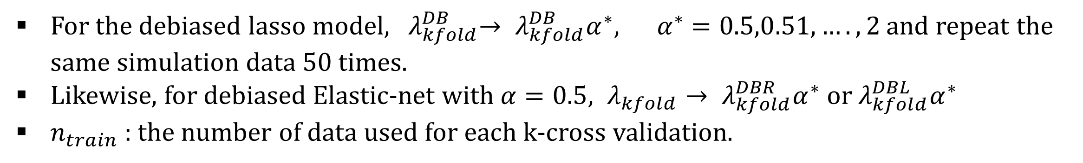
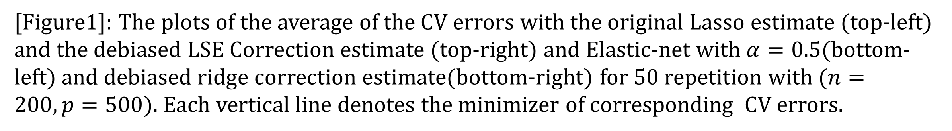
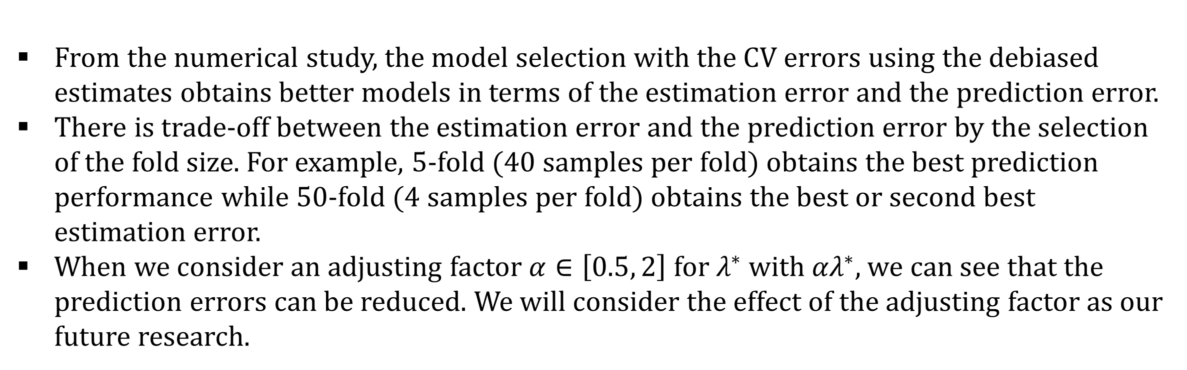
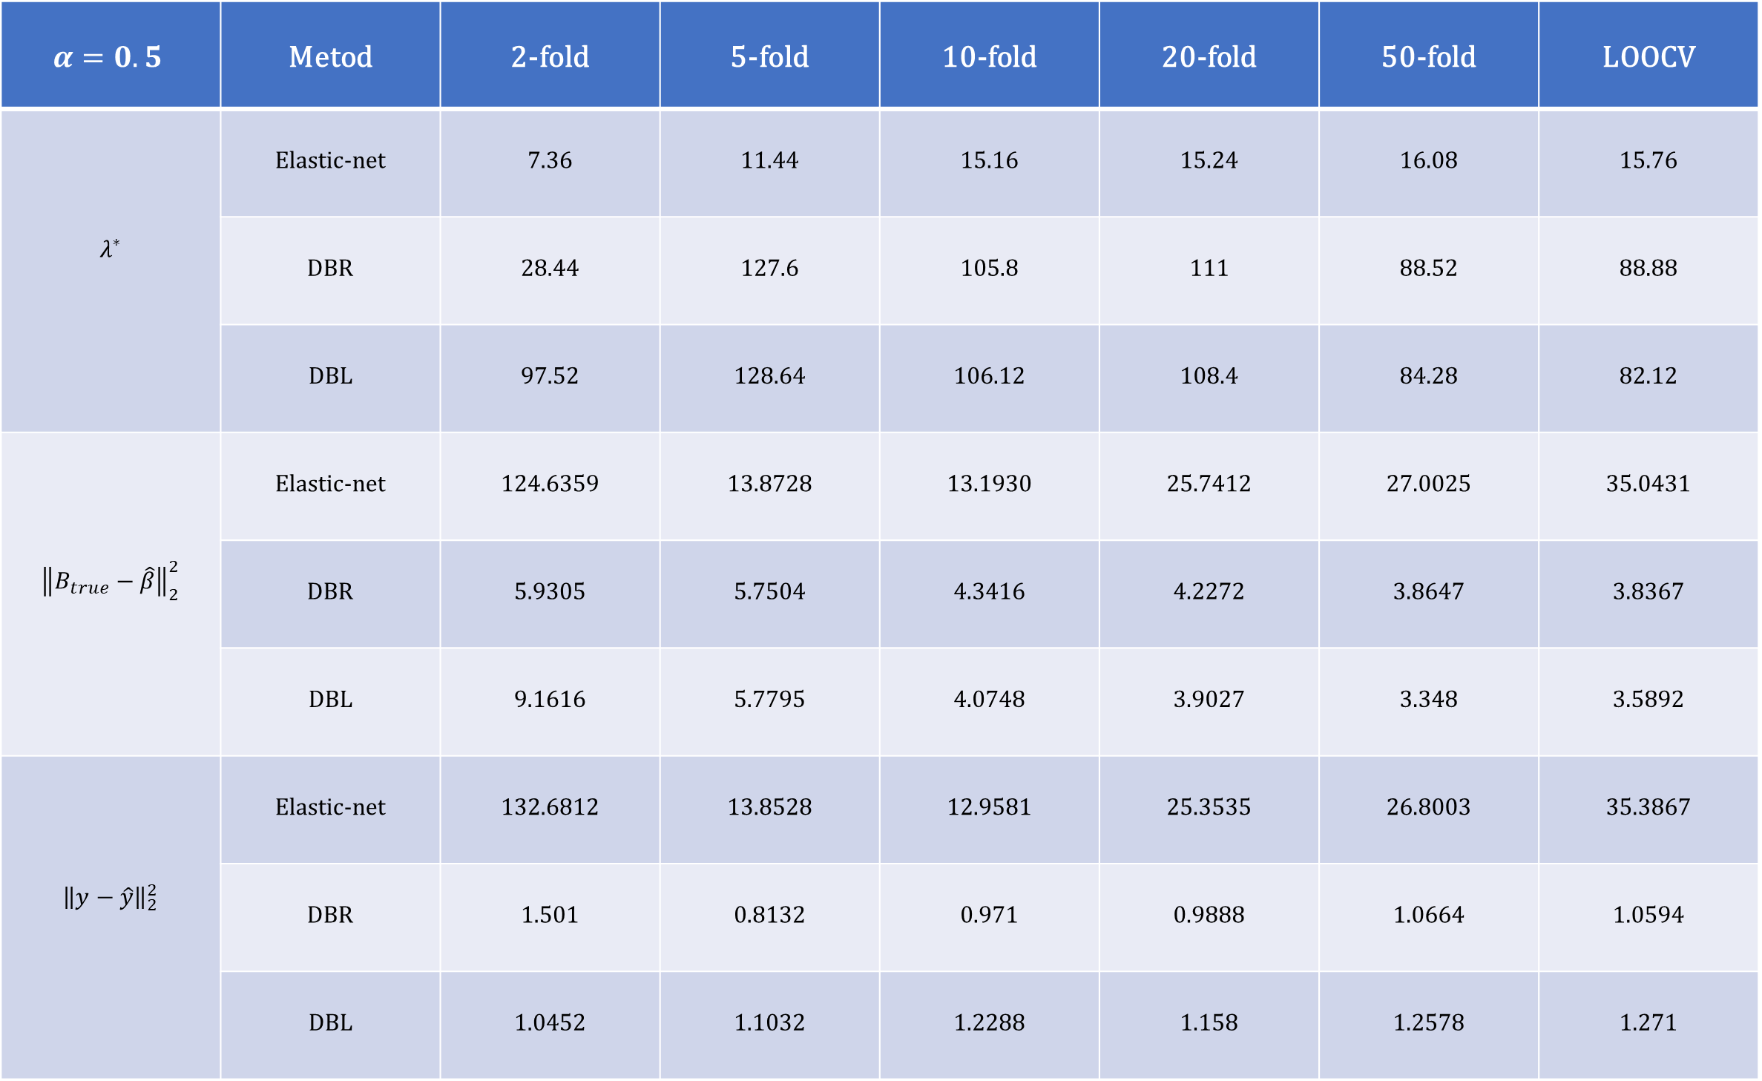
A simulation study on effects of fold size selection in K-fold cross-validation
for penalized regression models with Lasso and Elastic-net penalties
Junseok Lee , Donghyeon Yu
Department of Statistics, Inha university
Introduction
Estimation & prediction performance for Lasso
The estimator of the penalized regression model has a bias unlike the least-squares estimator of the original regression. For example, under the condition $X^{T}X=I,$
$${\hat{β}}_{λ}=sign\left(X^{T}y\right){\left(\left|X^{T}y\right|−λ\right)}_{+},$$
where ${\left(x\right)}_{+}=max⁡(0, x)$ .
The bias in the penalized regression model affects the tuning parameter selection.
In this paper, we focus on the tuning parameter selection with K-fold cross-validation (CV).
The minimizers of CV errors with the original Lasso estimate tend to be lower than that of the debiased estimate (see Figure 1).
[Table1] : Averages of the selected tuning parameter, estimation error, and prediction error of Lasso and debiased Lasso estimates for 50 repetitions.
 | Method | 2-fold | 5-fold | 10-fold | 20-fold | 50-fold | LOOCV
$$λ^{∗}$$ | Lasso | 0 | 2.544 | 1.6 | 2.12 | 1.672 | 0
 | DB-Lasso | 121.152 | 26.448 | 24.688 | 36.656 | 44.128 | 42.528
$${\left\|B_{true}−\hat{β}\right\|}_{2}^{2}$$ | Lasso | 77.92046 | 10.6743 | 1.4264 | 1.4109 | 1.44323 | 77.92046
 | DB-Lasso | 30.9006 | 5.1133 | 0.7592 | 0.6714 | 0.4776 | 0.4908
$${\left\|y−\hat{y}\right\|}_{2}^{2}$$ | Lasso | 76.8425 | 11.1346 | 1.6903 | 1.6761 | 1.7128 | 76.84246
 | DB-Lasso | 32.2605 | 5.7264 | 0.9935 | 0.8891 | 0.7165 | 0.7332
Estimation & prediction performance for Elastic-net
d
[Table2] : Averages of the selected tuning parameters, estimation errors, and prediction errors of Elastic-net and debiased Elastic-net estimates for 50 repetitions.
[Figure1]: The plots of the average of the CV errors with the original Lasso estimate (top-left) and the debiased LSE Correction estimate (top-right) and Elastic-net with $α=0.5$(bottom-left) and debiased ridge correction estimate(bottom-right) for 50 repetition with $(n=200,p=500)$. Each vertical line denotes the minimizer of corresponding CV errors.
$$α=0.5$$ | Metod | 2-fold | 5-fold | 10-fold | 20-fold | 50-fold | LOOCV
$$λ^{∗}$$ | Elastic-net | 7.36 | 11.44 | 15.16 | 15.24 | 16.08 | 15.76
 | DBR | 28.44 | 127.6 | 105.8 | 111 | 88.52 | 88.88
 | DBL | 97.52 | 128.64 | 106.12 | 108.4 | 84.28 | 82.12
$${\left\|B_{true}−\hat{β}\right\|}_{2}^{2}$$ | Elastic-net | 124.6359 | 13.8728 | 13.1930 | 25.7412 | 27.0025 | 35.0431
 | DBR | 5.9305 | 5.7504 | 4.3416 | 4.2272 | 3.8647 | 3.8367
 | DBL | 9.1616 | 5.7795 | 4.0748 | 3.9027 | 3.348 | 3.5892
$${\left\|y−\hat{y}\right\|}_{2}^{2}$$ | Elastic-net | 132.6812 | 13.8528 | 12.9581 | 25.3535 | 26.8003 | 35.3867
 | DBR | 1.501 | 0.8132 | 0.971 | 0.9888 | 1.0664 | 1.0594
 | DBL | 1.0452 | 1.1032 | 1.2288 | 1.158 | 1.2578 | 1.271
Original and debiased Lasso estimator
Karush-Kuhn-Tucker (KKT) condition of the Lasso regression,
$$X^{T}X{\hat{β}}_{λ }=X^{T}y − λs,$$
where $s=\left(s_{1},….., s_{p}\right), s_{i}=sign\left({\hat{β}}_{λ, i}\right) if {\hat{β}}_{λ, i }≠0, s_{i}∈\left[−1,1\right] if {\hat{β}}_{λ, i }=0$, and
$I_{λ} : \left\{j | {\hat{β}}_{λ, j}≠0\right\}.$
Lasso estimate and debiased estimate of coefficients for $I_{λ}$,
${\hat{β}}_{I_{λ}}^{DB}= {\left(X_{I_{λ}}^{T}X_{I_{λ}}\right)}^{−1}X_{I_{λ}}^{T}y, {\hat{β}}_{{{(I}_{λ})}^{c} }^{DB}=0$
${\hat{β}}_{λ,I_{λ}}= {\hat{β}}_{I_{λ}}^{LSE}−λ{\left(X_{I_{λ}}^{T}X_{I_{λ}}\right)}^{−1}sign({\hat{β}}_{λ,I_{λ}})$, ${\hat{β}}_{λ,{\left(I_{λ}\right)}^{c}}=0$
Original and debiased Elastic-net estimator
Karush-Kuhn-Tucker (KKT) condition of the Elastic-net regression,
$$\left(X^{T}X+λ\left(1−α\right)I_{p}\right){\hat{β}}_{(λ, α) }=X^{T}y − λα s,$$
where $s=\left(s_{1},….., s_{p}\right), s_{i}=sign\left({\hat{β}}_{(λ,α), i}\right) if {\hat{β}}_{(λ,α), i }≠0, s_{i}∈\left[−1,1\right] if {\hat{β}}_{(λ,α), i }=0$, and
$I_{λ,α} : \left\{j | {\hat{β}}_{λ, j}≠0\right\}.$
Elastic-net estimate and debiased estimates (LSE and ridge corrections) of coefficients for $I_{λ}$,
${\hat{β}}_{I_{λ}}^{DBL}= {\left(X_{I_{λ}}^{T}X_{I_{λ}}\right)}^{−1}X_{I_{λ}}^{T}y, {\hat{β}}_{{{(I}_{λ})}^{c} }^{DBL}=0$ (LSE correction)
${\hat{β}}_{\left(λ, α\right),I_{λ}}^{DBR}= {\left(X_{I_{λ}}^{T}X_{I_{λ}}+λ\left(1−α\right)I_{p}\right)}^{−1}X_{I_{λ}}^{T}y, {\hat{β}}_{\left(λ, α\right), {{(I}_{λ})}^{c} }^{DBR}=0$ (ridge correction)
${\hat{β}}_{\left(λ, α\right),I_{λ}}={\hat{β}}_{\left(λ, α\right),I_{λ}}^{DBR}−λα{\left(X_{I_{λ}}^{T}X_{I_{λ}}+λ\left(1−α\right)I_{p}\right)}^{−1}sign\left({\hat{β}}_{\left(λ, α\right),I_{λ}}\right), {\hat{β}}_{\left(λ,α\right),{\left(I_{λ}\right)}^{c}}=0$
Tuning parameter correction
For the debiased lasso model, ${ λ}_{kfold}^{DB}→ λ_{kfold}^{DB}α^{∗}, { α}^{∗}=0.5,0.51,….,2$ and repeat the same simulation data 50 times.
Likewise, for debiased Elastic-net with $α=0.5, λ_{kfold}→ λ_{kfold}^{DBR}α^{∗}$ or $λ_{kfold}^{DBL}α^{∗}$
$n_{train}$ : the number of data used for each k-cross validation.
d
Numerical Studies
Dimension of dataset $(n,p)$: (200,500) with 50 repetitions.
A dataset for Lasso:$X={\left(x_{1},x_{2}…, x_{n}\right)}^{T},x_{i} \sim N(0, 0.25I_{p})$
Elastic-net with a search grid $\{0,0.1,…,1\}$ for $α$
A dataset for Elastic-net: $X={\left(x_{1},x_{2}…, x_{n}\right)}^{T},x_{i} \sim N(0, Σ)$
${\left(Σ\right)}_{ij}=\left\{\begin{aligned}0.4 if \left|i−j\right|=1,2 \\ 1 if i=j \\ 0 otherwise \end{aligned}\right.$ $= \left[\begin{matrix}\begin{matrix}1 & 0.4 & 0.4 \\ & 1 & 0.4 \\ & & ⋱\end{matrix} & \begin{matrix}0 & ⋯ & 0 \\ ⋱ & ⋱ & ⋮ \\ ⋱ & ⋱ & 0\end{matrix} \\ symm & \begin{matrix}⋱ & 0.4 & 0.4 \\ & 1 & 0.4 \\ & & 1\end{matrix}\end{matrix}\right]$
In common,
$$y_{i}=x_{i}^{T}β+ε_{i} , ε_{i} \sim N\left(0,1\right), β_{j}\left(true\right)= \left\{\begin{aligned}2 for j=1,…, 20 \\ −1 for j=21,…, 25 \\ 3 for j=26,…,50 \\ 0 otherwise \end{aligned}\right.$$
$N^{\left(k\right)}, y^{\left(k\right)}, X^{\left(k\right)}$ : corresponding to kth-fold, ${\hat{β}}_{DB}^{\left(−k\right)}$ : obtained value by training the data excluding kth-fold.
$$CV_{DB}=\frac{1}{K}\sum_{k=1}^{K}{{\frac{1}{N^{\left(k\right)}}\left\|y^{\left(k\right)}−X^{\left(k\right)}{\hat{β}}_{DB}^{\left(−k\right)}\right\|}_{2}^{2}}$$
$β$Estimation & test-error are measured by $ℓ2− norm\left({\left\|∙\right\|}_{2}\right).$
$$err_{test}=\frac{1}{n}\sum_{i=1}^{n}{{\left\|y_{i}^{true}−{\hat{y}}_{i}\right\|}_{2}^{2}}$$
Simulation
[Figure2] Boxplots of the factor $α^{∗}$ that minimizes the prediction errors with $λ= λ_{}^{DB}α^{∗}$.
Conclusion
From the numerical study, the model selection with the CV errors using the debiased estimates obtains better models in terms of the estimation error and the prediction error.
There is trade-off between the estimation error and the prediction error by the selection of the fold size. For example, 5-fold (40 samples per fold) obtains the best prediction performance while 50-fold (4 samples per fold) obtains the best or second best estimation error.
When we consider an adjusting factor $α∈\left[0.5, 2\right]$ for $λ^{∗}$ with ${αλ}^{∗}$, we can see that the prediction errors can be reduced. We will consider the effect of the adjusting factor as our future research.
d
Reference
[1] Donghyeon Yu. (2016). A study on bias effect of LASSO regression for model selection criteria. The Korean Journal of Applied Statistics, 29(4), 643-356
[2] Jun Shao. (1993). Linear Model Selection by Cross-validation, Journal of the American statistics Association. 88:422, 486-494.
[3] Yoonsuh Jung & Jianhua Hu.(2015). A K-fold Averaging Cross-validation Procedure. Journal of Nonparametric Statistics. 27(2):1-13
[4] Friedman, J., Hastie, T. and Tibshirani, R. (2008) Regularization Paths for Generalized Linear Models via Coordinate Descent, Journal of Statistical Software, Vol. 33(1), 1-22

